Slide 1
SERVE AND SHOP
PROJECT FINAL REVIEW – ECE 651
Prepared By – GROUP 17
Abhi Rajendra Zanzarukiya | 20892635
Heli Mistry | 20985952
Niravkumar Talaviya | 20896128
Shanthi Meena Arumugam | 20986268

Slide 2
INDEX
Overview
System Design
Feedback from Mid-Term Review
Development Practices
GitLab Issue Board
Testing
UI Testing Report
Integration Testing Report
Unit Testing Report
Coverage
Code Contribution
UI Demo Video

Slide 3
APPLICATION OVERVIEW
Web-Application to enable community-based purchase and delivery of items
Enables a P2P interaction amongst its people
Users can place orders in group(s), and a reliable member can serve his request at very nominal rates
Builds a solid trust-based community inclusion

Slide 4
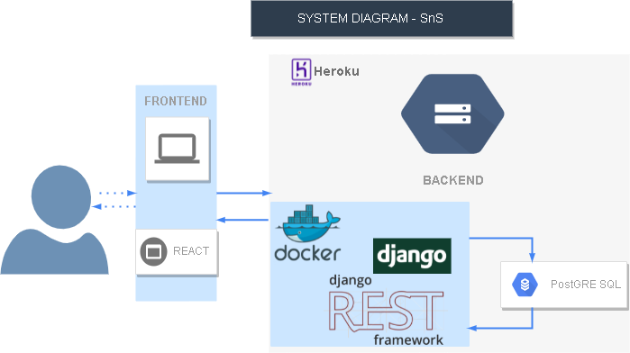
SYSTEM DESIGN

Slide 5

FEEDBACK FROM MID-TERM REVIEW
Test and coverage report
Add UI
Add more tests

Slide 6
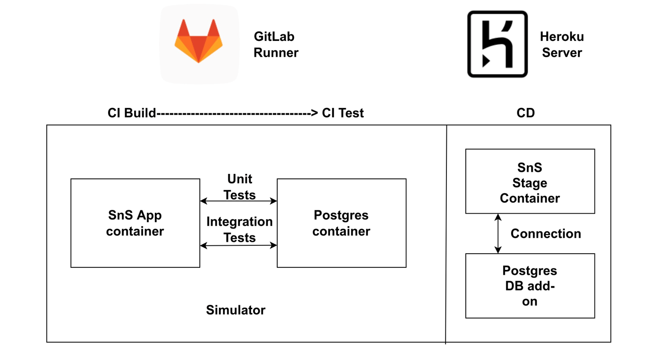
DEVELOPMENT PRACTICES
Agile Methodology
Version Control: GitLab
Project management tool: GitLab Issue Board
Weekly Scrum meetings
CI/CD run

Slide 7
DEVELOPMENT PRACTICES (Cont.)
Git Branches:
QA branch
Dev branches

Slide 8
GITLAB ISSUE BOARD
4 Sprints after mid-term
Board: https://git.uwaterloo.ca/group171/ece651-sns/-/boards?scope=all&utf8=%E2%9C%93
Flow: TODO -> In Progress -> Completed
Sample Milestone: https://git.uwaterloo.ca/group171/ece651-sns/-/milestones/11

Slide 9
TESTING
UI Automation Testing: Selenium
Integration Testing: PyTest
Unit Test: Django Test Framework

Slide 10
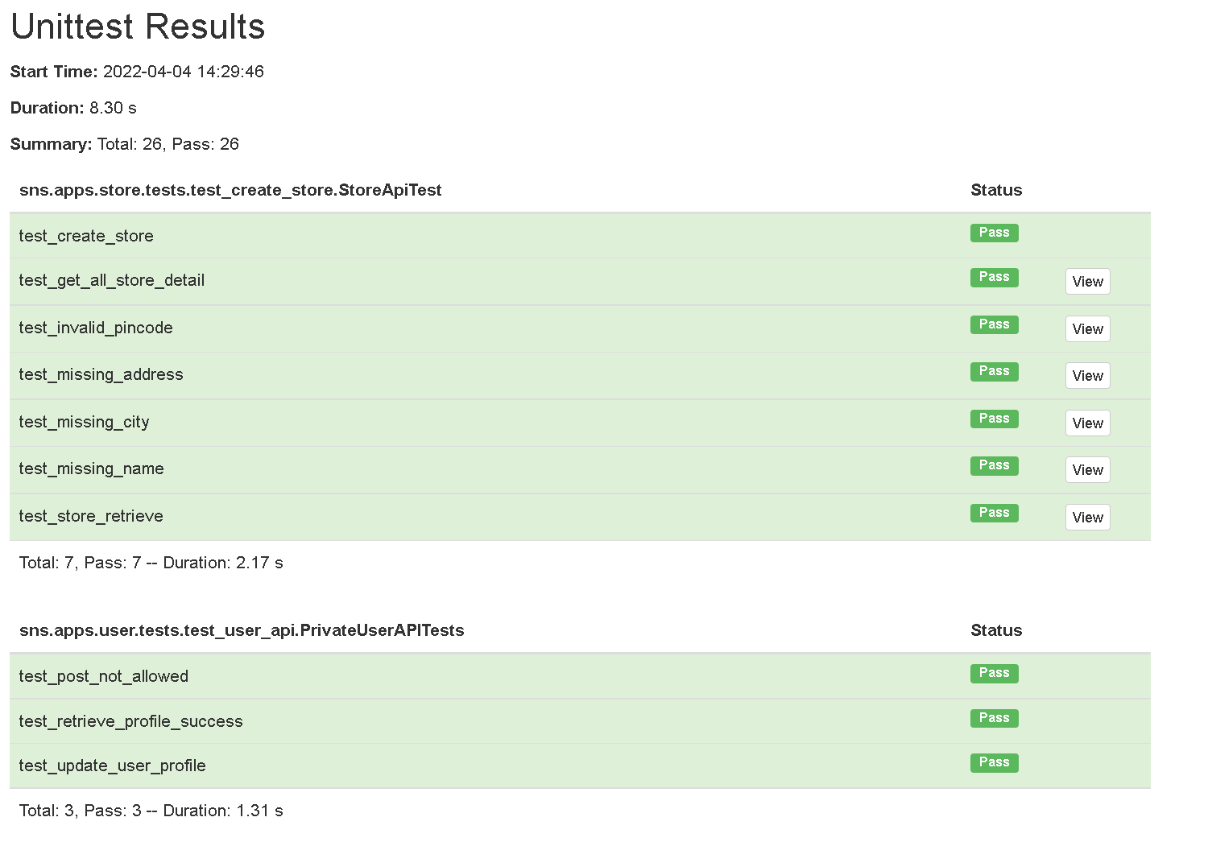
UNIT TEST REPORT
Unit Test: Django Test Framework

Slide 11
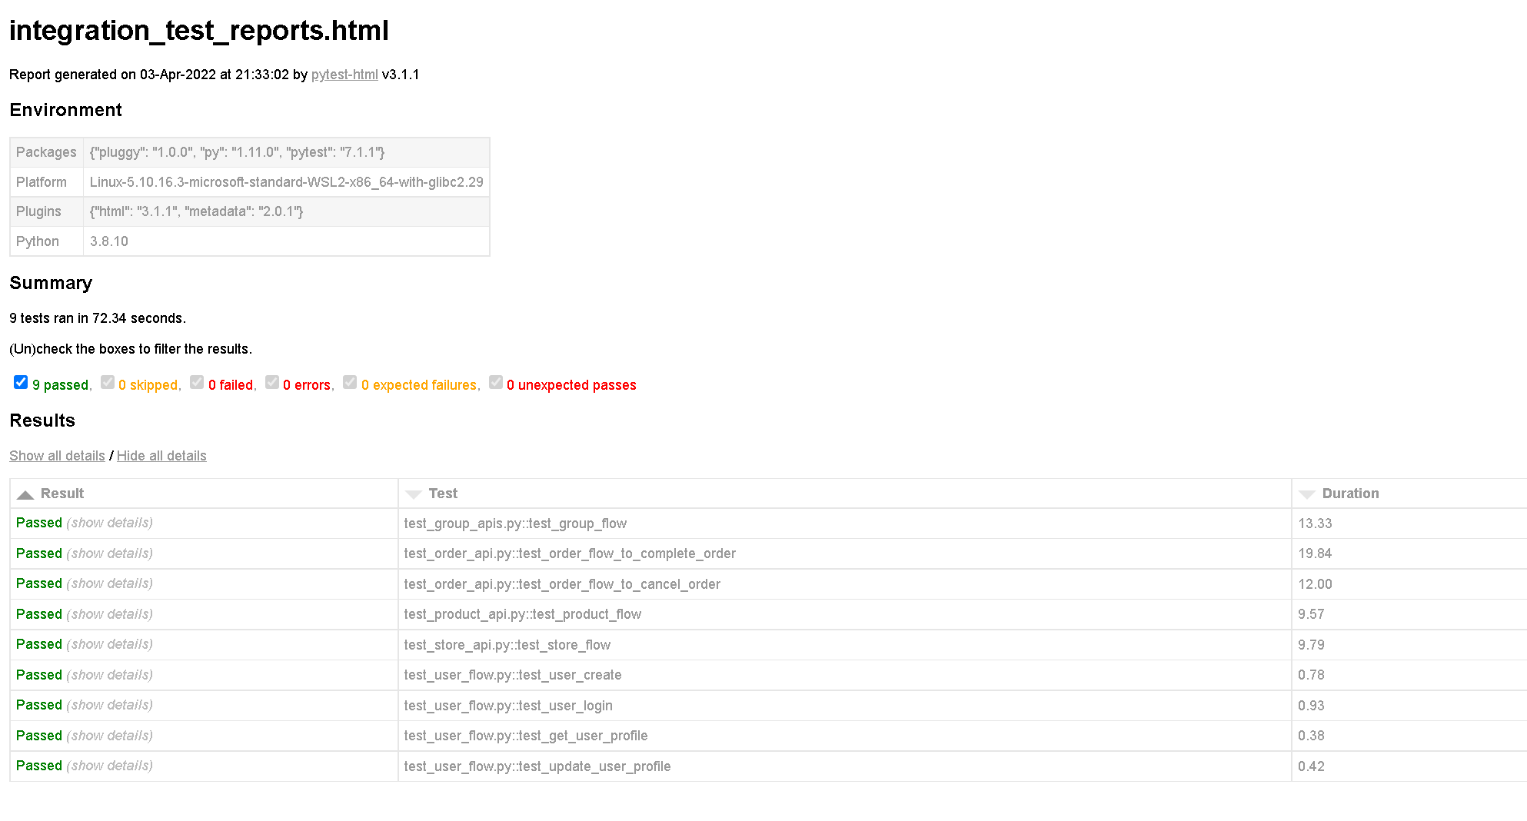
INTEGRATION TEST REPORT
Integration Testing: PyTest

Slide 12
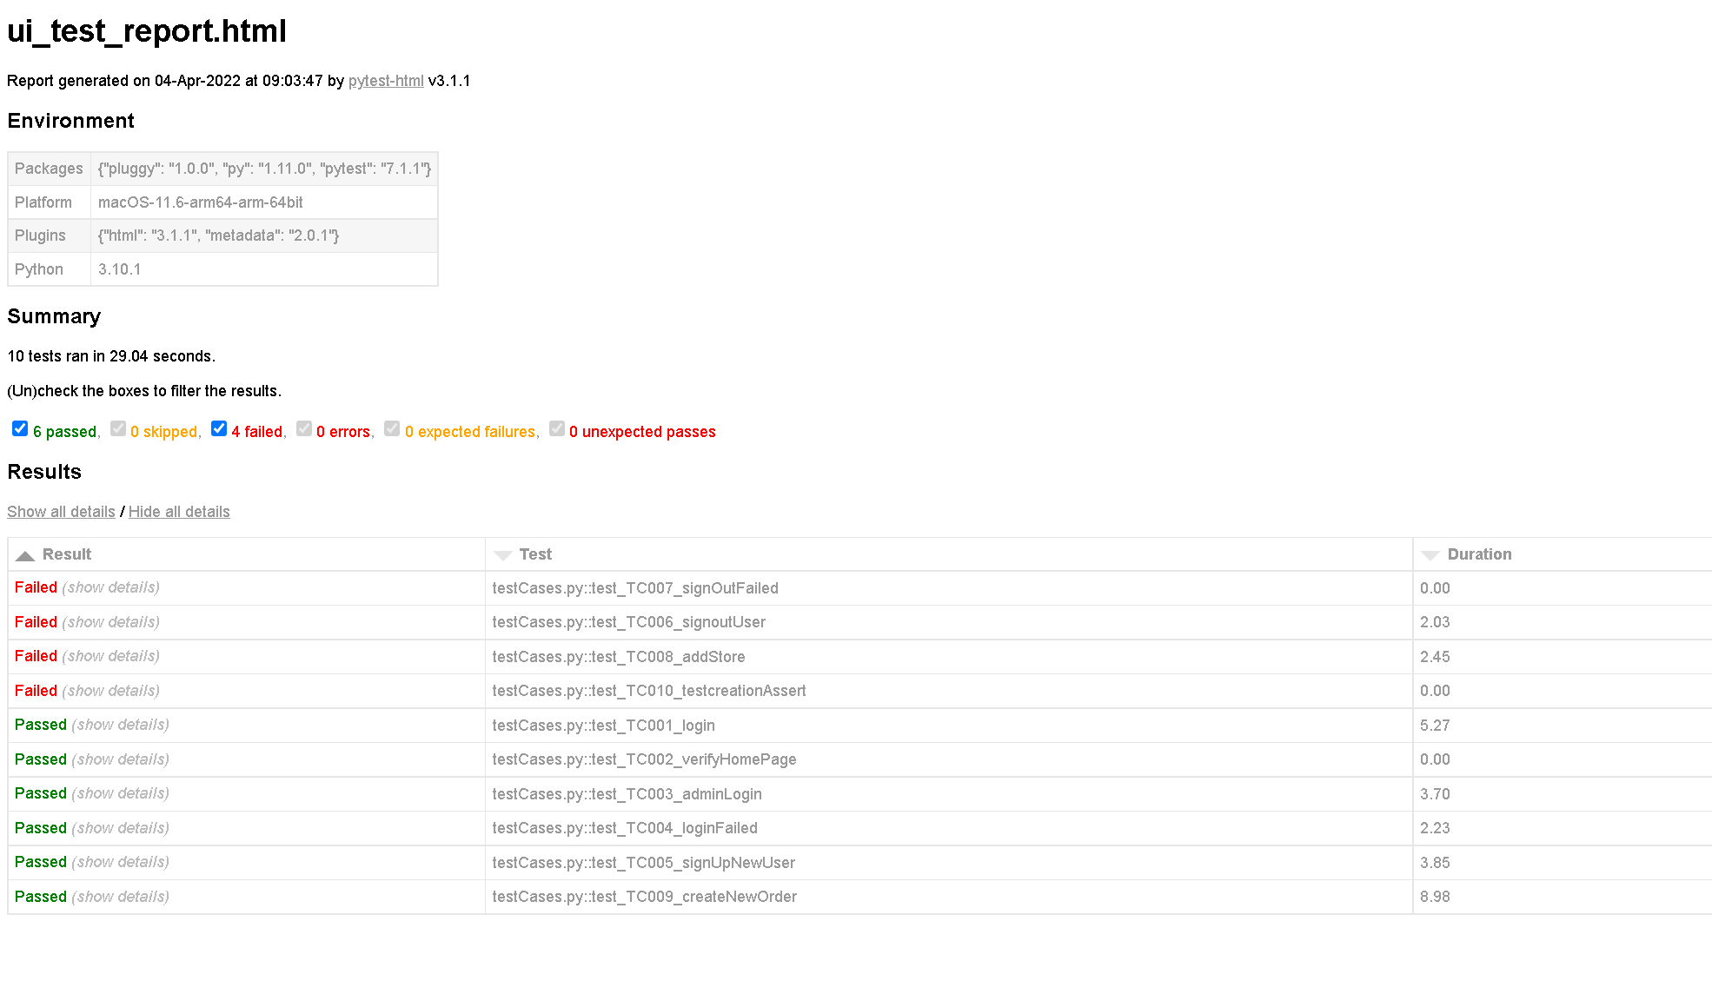
UI TESTING REPORT
UI Automation Testing: Selenium

Slide 13
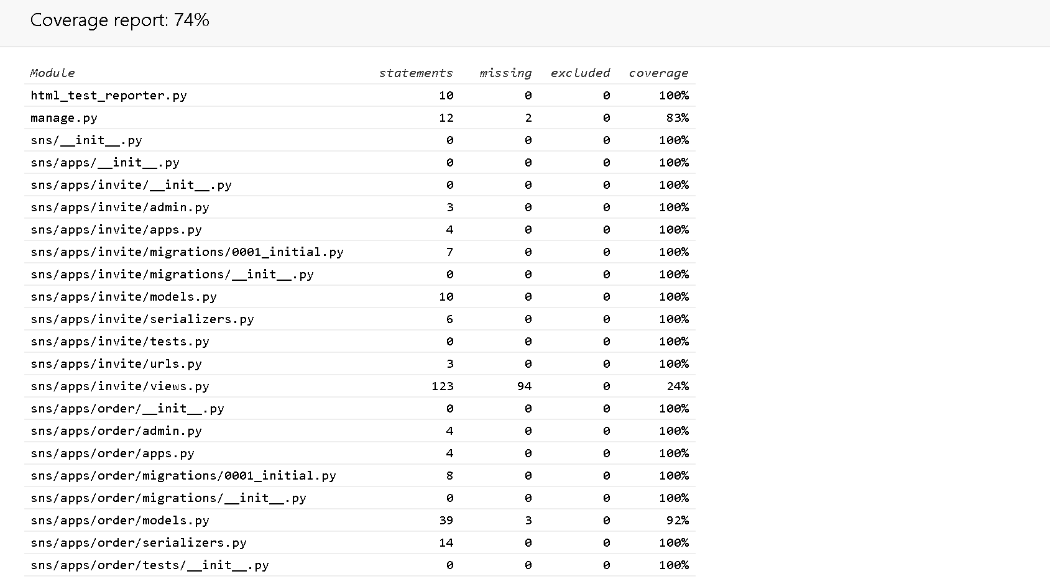
CODE COVERAGE REPORT

Slide 14
CODE CONTRIBUTION
https://git.uwaterloo.ca/group171/ece651-sns/-/graphs/QA_branch

Slide 15

DEMO

Slide 16
THANK YOU

